Slide 1


Predicting Healthcare Costs with Regression Analysis
Data Analytics Project for Health Insurance Optimization

Slide 2
Objective: To predict healthcare costs for insurance customers to help guide personalized healthcare planning and cost management.
Problem Statement: Healthcare cost prediction enables better resource allocation for insurance providers and aids customers in effective budgeting for healthcare expenses.

Slide 3
Objectives
Accurately predict healthcare costs using customer data.
Implement a scalable model to generalize predictions to new customer data.
Explore and visualize key relationships in data (e.g., smoking habits and costs).

Slide 4
Data Overview
Key Features:
age: Age of primary beneficiary
sex: Gender of the insurance holder
BMI: Body Mass Index
children: Number of dependents
smoker: Smoking status (Yes/No)
region: Residential region (e.g., Northeast, Southwest)
charges: Medical costs billed
Dataset: insurance.csv with variables such as age, gender, BMI, smoker status, region, and charges.

Slide 5
Data Preprocessing
Data Cleaning:
Missing values handled
Categories standardized (e.g., regions, gender, smoker as Boolean)
Charges converted to float
Feature Engineering:
Dummy variables created for categorical data
New binary columns (e.g., is_male) for better model integration

Slide 6
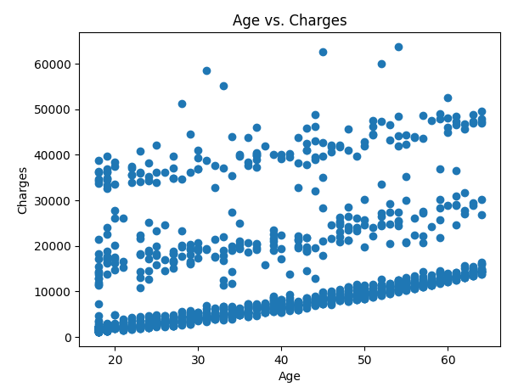
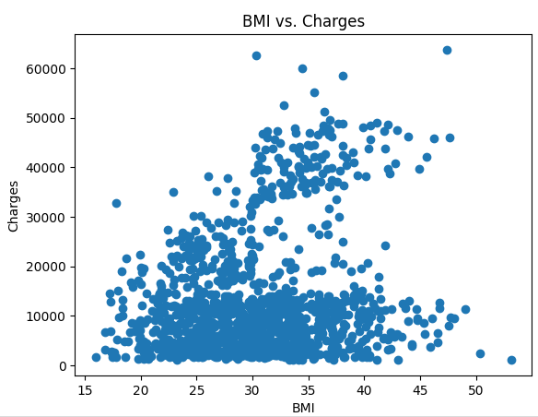
Exploratory Data Analysis (EDA)
Scatterplots and visualizations examining correlations
Age vs. Charges: Highlight any trends found.
BMI vs. Charges: Demonstrate BMI's impact on costs.
Smoker vs. Charges: Identify any regional cost differences.

Slide 7
Modeling Approach
Model Selection:
Linear Regression chosen as a baseline model.
Training Process:
Data split into training and testing sets.
Linear Regression applied to fit the model on training data.
Evaluation Metric: R-squared to measure fit accuracy.

Slide 8
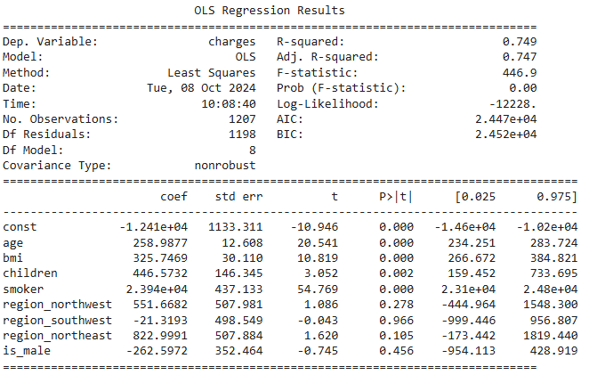
Results and Evaluation
R-squared Score:
Present the R-squared score obtained from the test set, indicating model performance.
Model Predictions:
Predictions on validation dataset
Highlight key insights or anomalies from prediction results.

Slide 9
Conclusions
Coefficients (coef):These represent the estimated effect of each independent variable on the dependent variable (insurance charges). In a multiple regression, each coefficient shows how much the dependent variable is expected to change, on average, with a one-unit change in the predictor, holding all other predictors constant.
age: This coefficient shows the expected change in insurance charges for a one-year increase in age, holding all other variables constant.
bmi: This coefficient shows the expected change in insurance charges for a one-unit increase in BMI, holding all other variables constant. A positive coefficient would mean that as BMI increases, the insurance charges increase.
children: This coefficient represents the change in insurance charges with each additional child.
smoker: This is a binary variable (1 for smokers, 0 for non-smokers). The coefficient for smoker shows how much more (or less) a smoker is expected to pay in insurance charges compared to a non-smoker, holding all other variables constant.

